Slide 1


Computer Vision Workshop
www.ugm.ac.id
Locally Rooted, Globally Respected

Slide 2
Table of Content
Data Preprocessing
Deep Learning for Computer Vision
Feature Extraction
Deep Learning Application in Computer Vision

Slide 3
Data Preprocessing in Computer Vision

Slide 4
Why Data Preprocessing?
Standardization: Uniform image dimensions are crucial for model training, especially for CNNs, ensuring consistent input shapes.
Stability and Reduced Variance: Normalizing pixel values to a specific range enhances model stability and feature detection by minimizing data variance.
Robustness Improvement: Image augmentation generates diverse training data through random transformations, preventing overfitting and increasing model robustness to real-world variations.

Slide 5
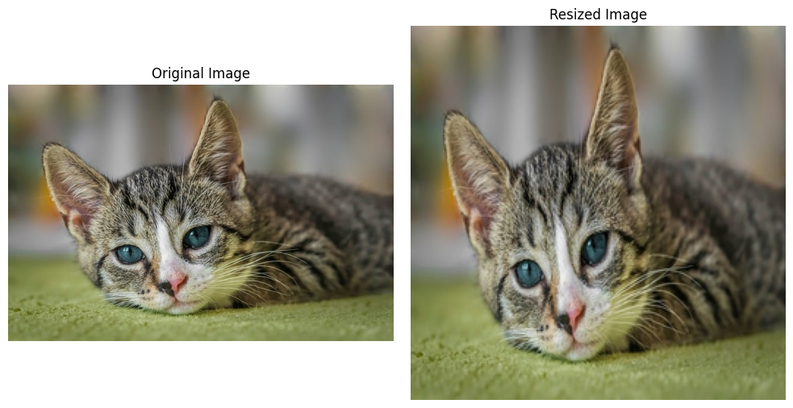
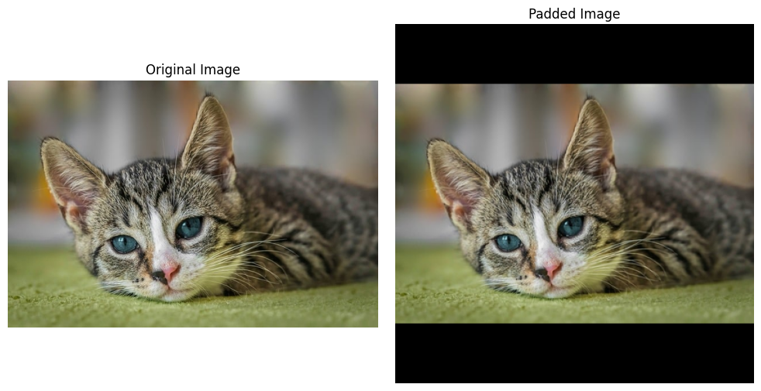
Resizing and Normalization
Image Resizing ensures uniform input sizes, especially for CNNs.
Direct Resizing
Padding

Slide 6
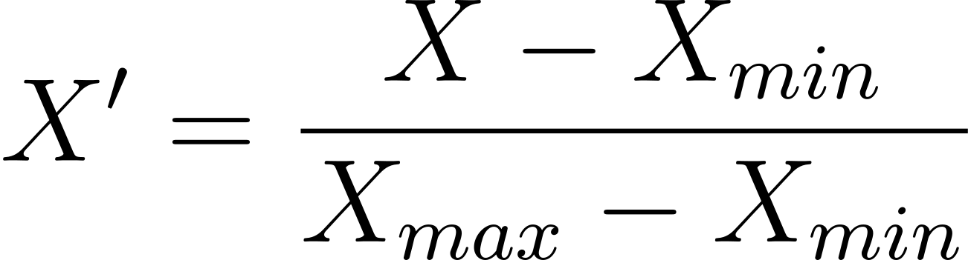
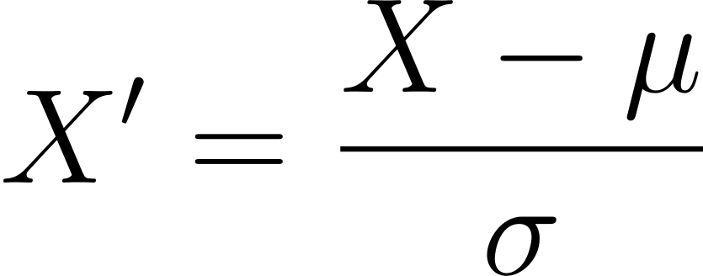
Resizing and Normalization
Image Normalization adjusts pixel values to a standard range (e.g., [0, 1] or [-1, 1]), stabilizing the training process and speeding up convergence.
Min-Max Scaling
Z-score Normalization

Slide 7
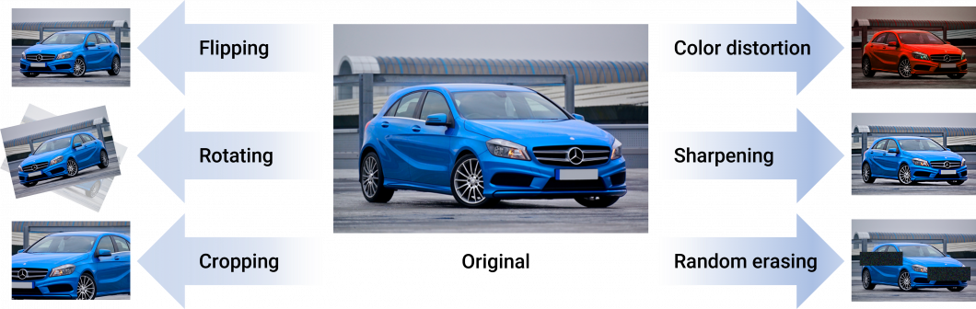
Data Augmentation Techniques
Why augmenting data?
Helps models generalize better to unseen data by increase training data variability.

Slide 8
Hands-on Activity: Preprocessing
Colab: bit.ly/comviz-c1 atau https://bit.ly/comviz-c1-colab

Slide 9
Deep Learning for Computer Vision

Slide 10
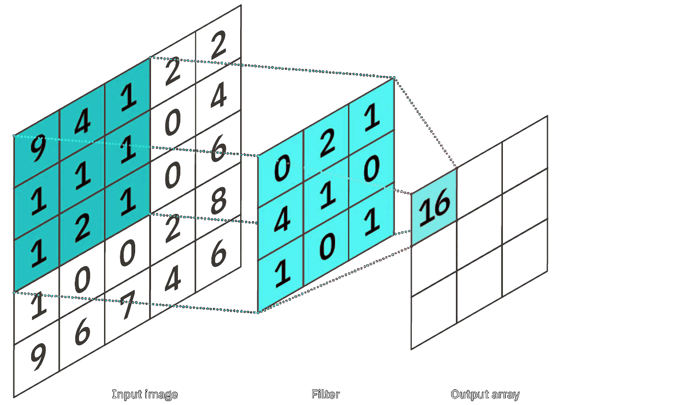
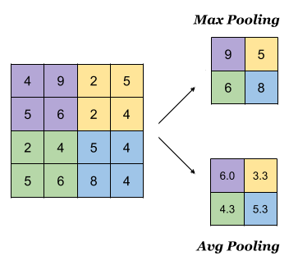
Overview of Convolutional Neural Networks (CNNs)
a Deep Learning algorithm that can take in an input image, assign importance (learnable weights and biases) to various aspects/objects in the image, and be able to differentiate one from the other.
Convolution Operation
Pooling Operation

Slide 11
Feature Extraction

Slide 12
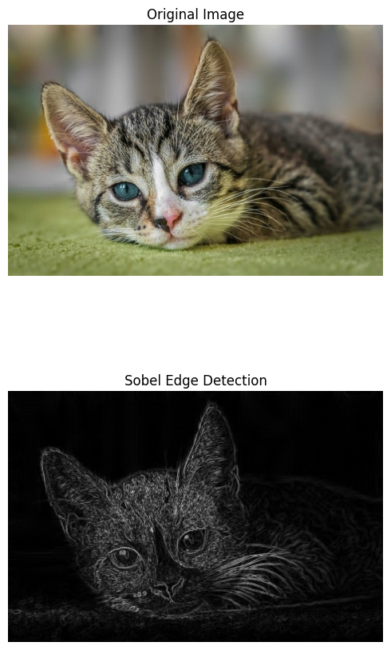
Traditional Feature Extraction: Edge Detection
Sobel Operator
The Sobel operator detects edges by calculating the gradient of image intensity.
It uses convolution with two 3x3 kernels to estimate gradients in the X and Y directions, highlighting areas where intensity changes sharply.
Sobel is useful for edge detection in basic scenarios but may be sensitive to noise.

Slide 13
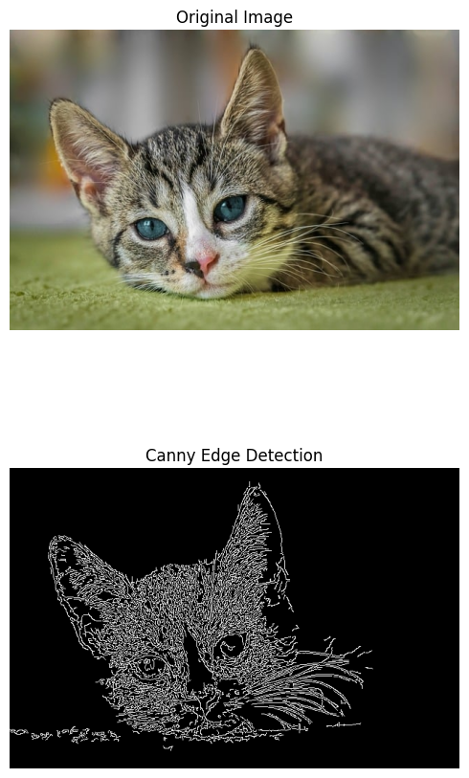
Traditional Feature Extraction: Edge Detection
Canny Edge Detection
Canny edge detection is a multi-step process that includes noise reduction using Gaussian filtering, gradient calculation, non-maximum suppression, and edge tracing with hysteresis.
It is more accurate than Sobel and can detect thinner, more refined edges while being less sensitive to noise.

Slide 14
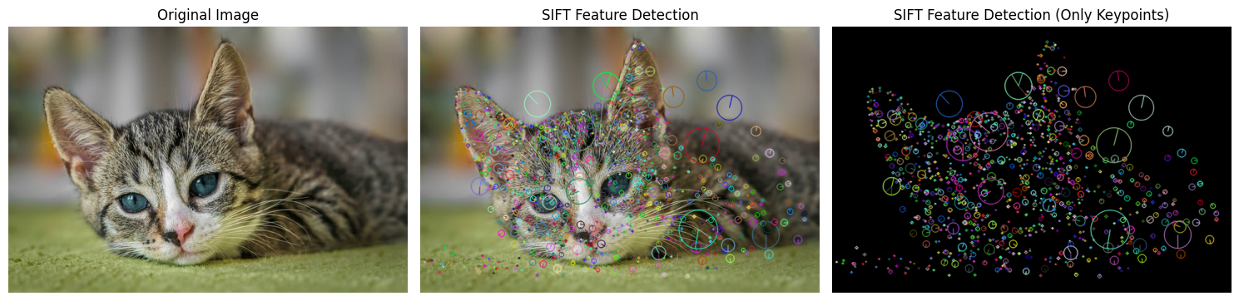
Traditional Feature Extraction: Keypoint Detection
SIFT (Scale-Invariant Feature Transform)
SIFT detects keypoints based on differences in scale-space using a Difference of Gaussian (DoG). Each keypoint is assigned a descriptor that is invariant to scale, rotation, and lighting changes.
It is particularly useful for matching objects across different scales and rotations.

Slide 15
Hands-on Activity: Edge & Keypoint Detection
Colab: bit.ly/comviz-c2 atau https://bit.ly/comviz-c2-colab

Slide 16

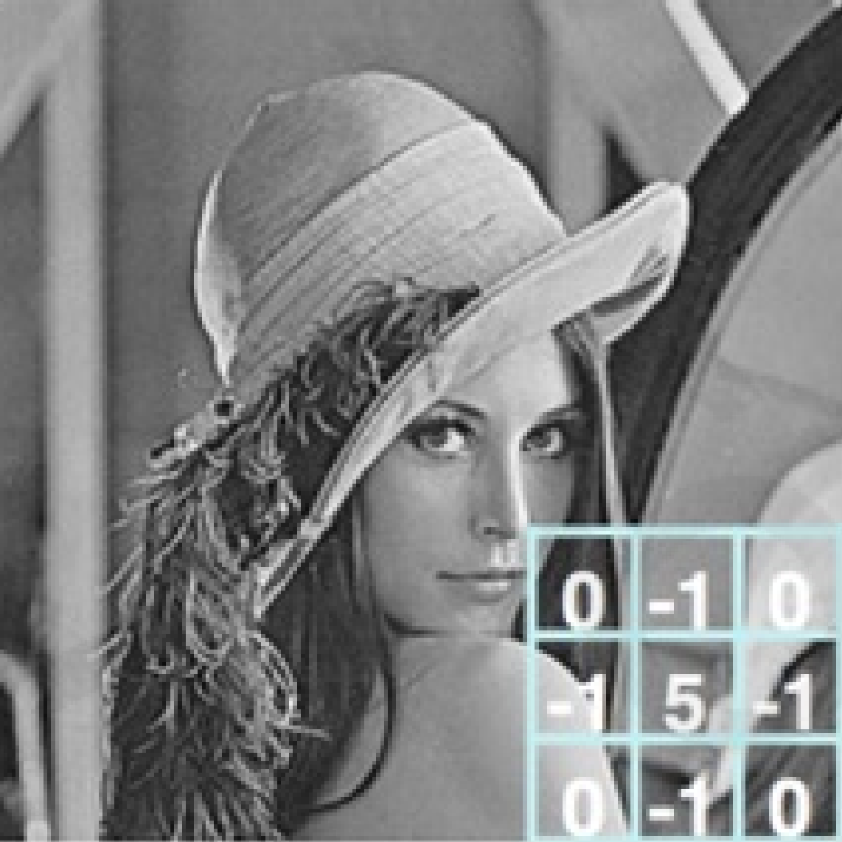
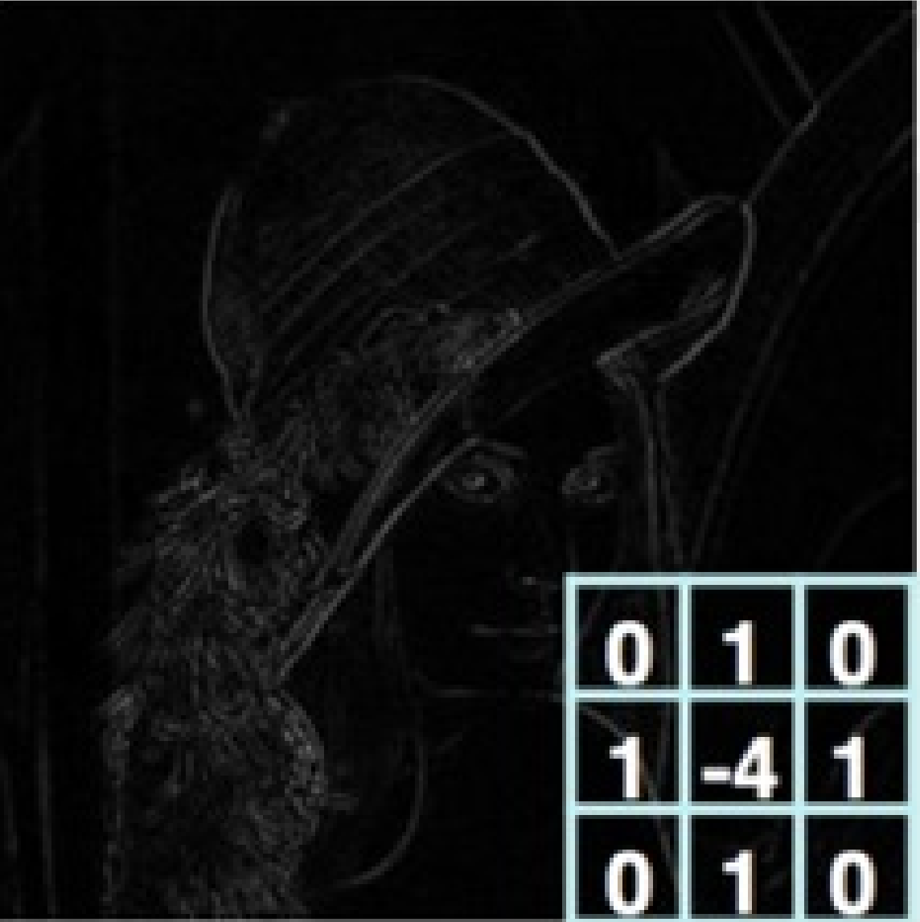
DL Feature Extraction: Feature Maps
Original
Sharpen
Edge Detect

Slide 17
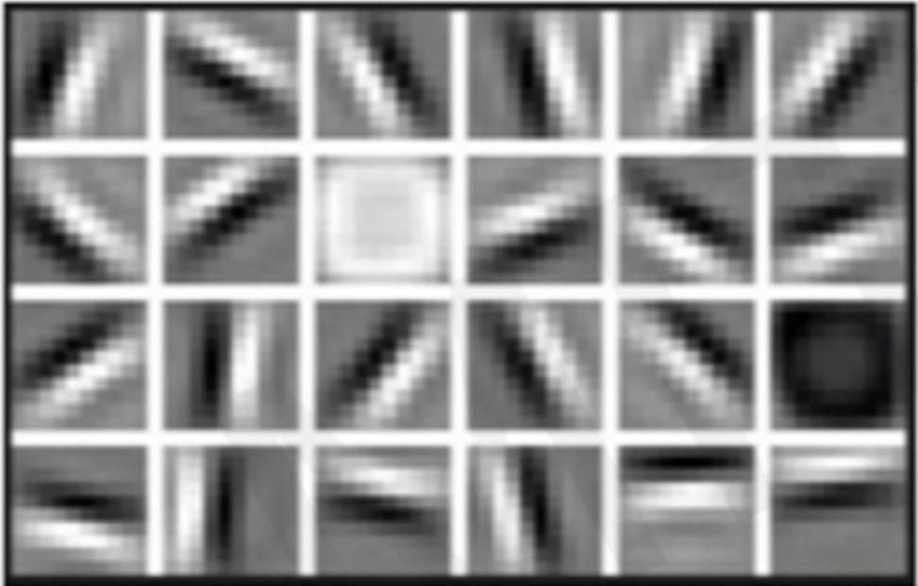
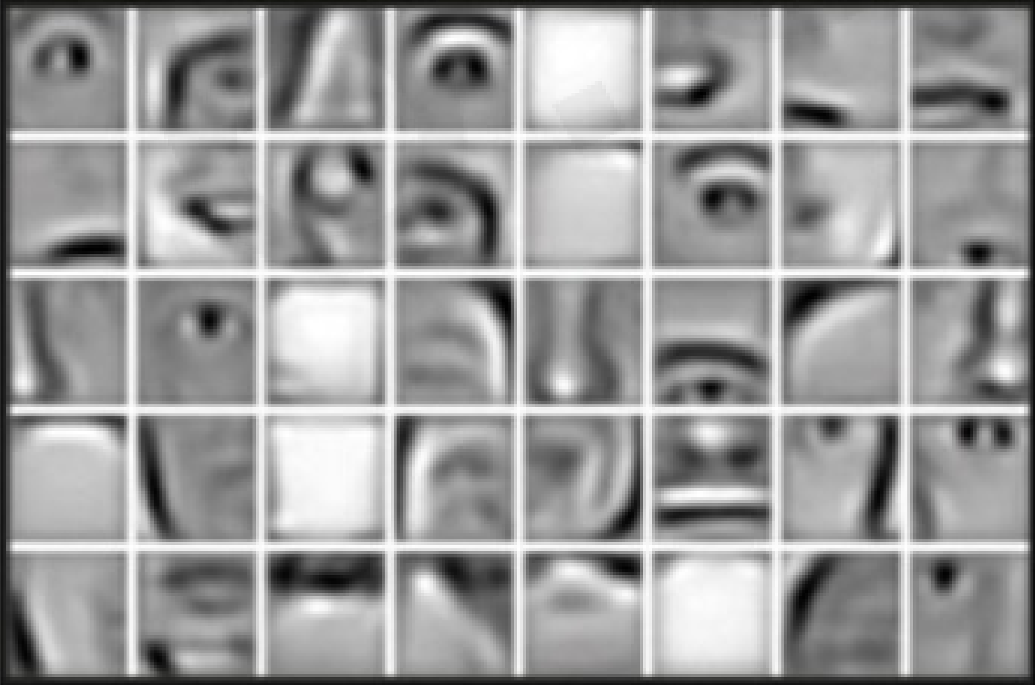
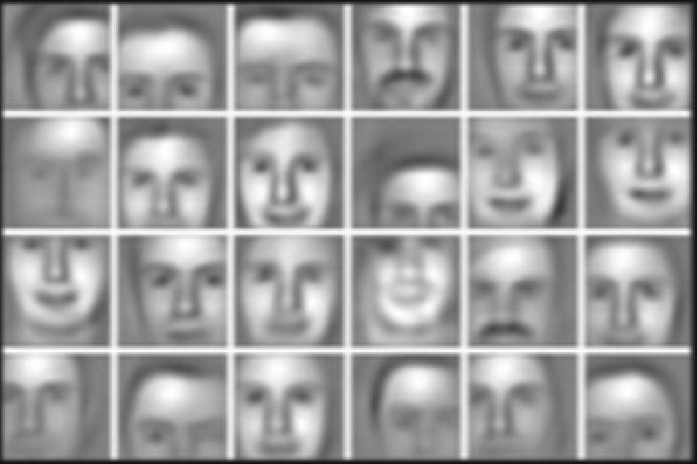
DL Feature Ext..: Hierarchical Feature Learning
Low level features
Mid level features
High level features
Lines & Edges
Eyes, Nose, & Ears
Facial Structures

Slide 18
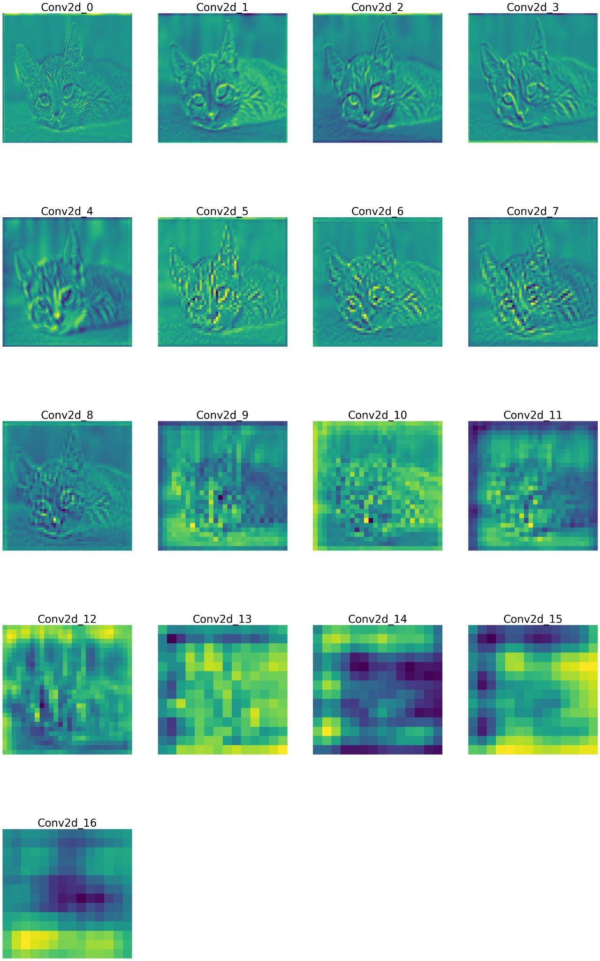
DL Feature Extraction: Transfer Learning
Transfer learning involves using pre-trained models, such as ResNet or VGG, that have already learned to extract features from large datasets like ImageNet.
Reduces training time significantly, as the model already understands fundamental features like edges, textures, and patterns.
Improves performance, especially when training with limited data, by leveraging pre-existing knowledge.

Slide 19
Hands-on Activity: Visualizing Feature Maps
Colab: bit.ly/comviz-c3 atau https://bit.ly/comviz-c3-colab

Slide 20
Deep Learning Applications in Computer Vision

Slide 21
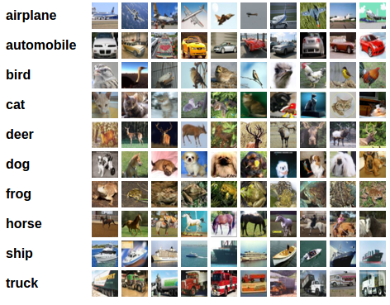
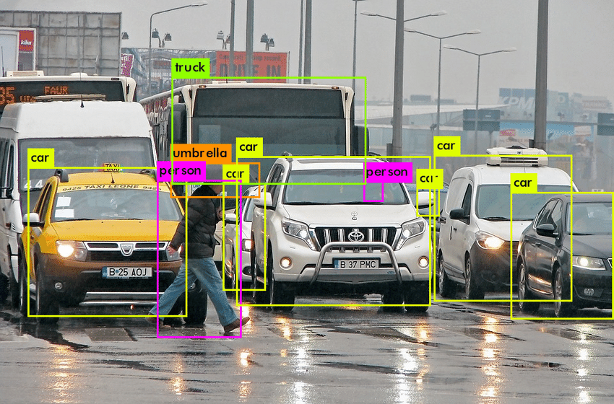
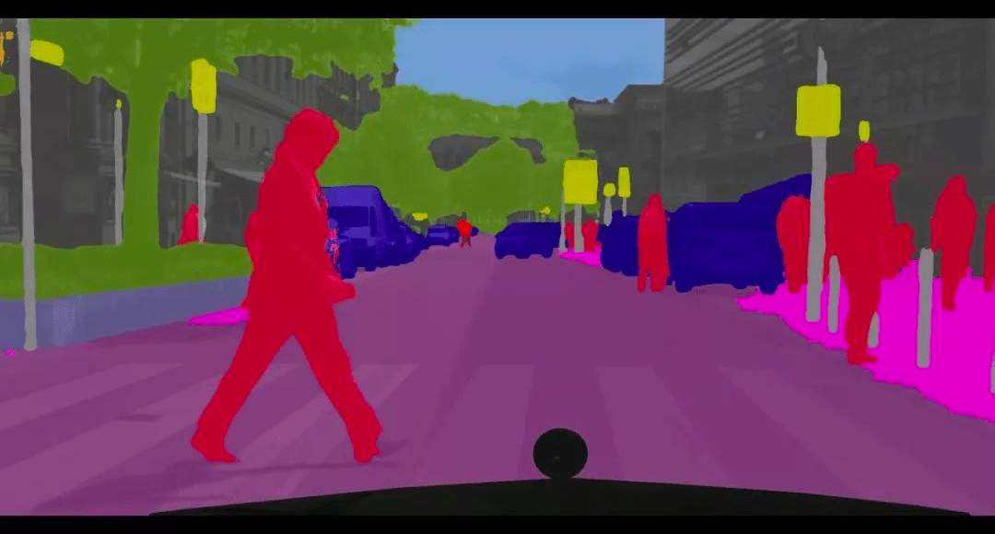
Overview of Core Applications
Image Classification
Object Detection
Image Segmentation

Slide 22
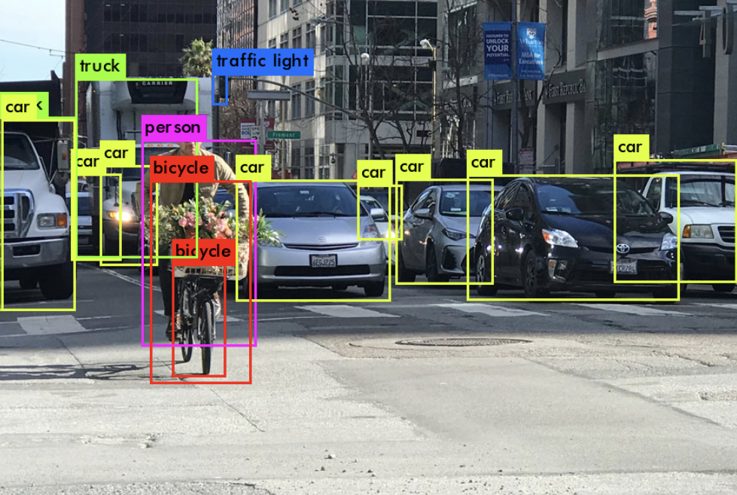
Object Detection
Given an input image, object detection aims at localizing objects of interest with rectangle boxes and class labels (usually called bounding boxes)

Slide 23
Object Detection Methods
Overview of popular methods: YOLO, SSD, Faster R-CNN.
Differences in speed and accuracy.
Visuals: Comparative diagram of the methods.

Slide 24
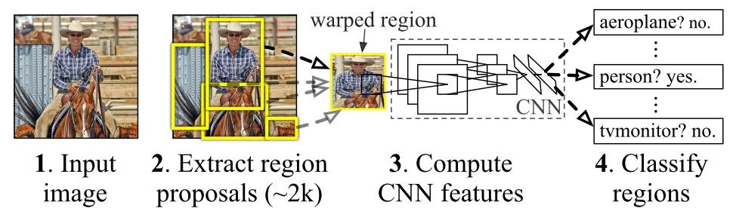
Object Detection Methods: R-CNN Variants
R-CNN (Region-based Convolutional Neural Network) methods aim to identify and classify objects within an image by generating region proposals.
These methods are well-known for their accuracy in object detection tasks and have evolved over time to become more efficient.

Slide 25
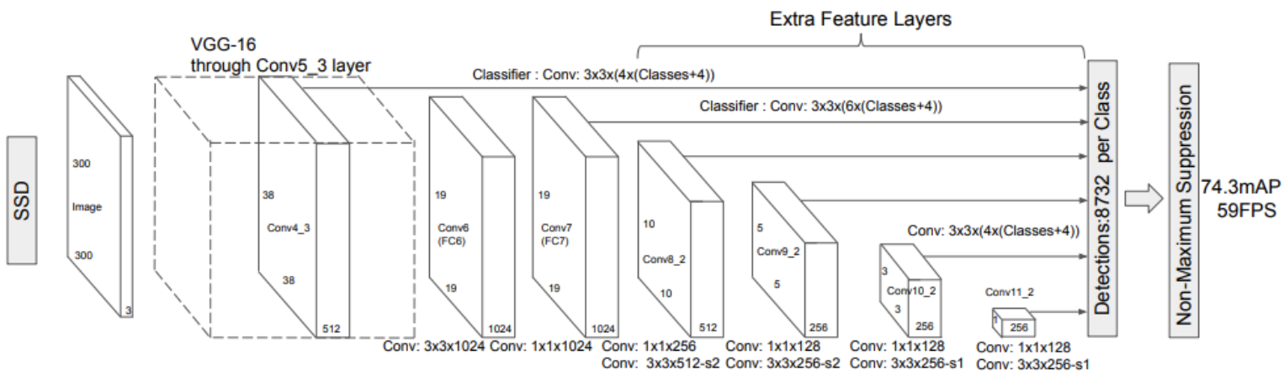
Object Detection Methods: SSD
Single-shot Detector (SSD) is an one-stage detector. It can be viewed as just using the RPN part of Faster R-CNN to generate object detection boxes
It doesn’t adopt FPN but still uses feature maps of different scales to generate object detection boxes corresponding to different scales

Slide 26
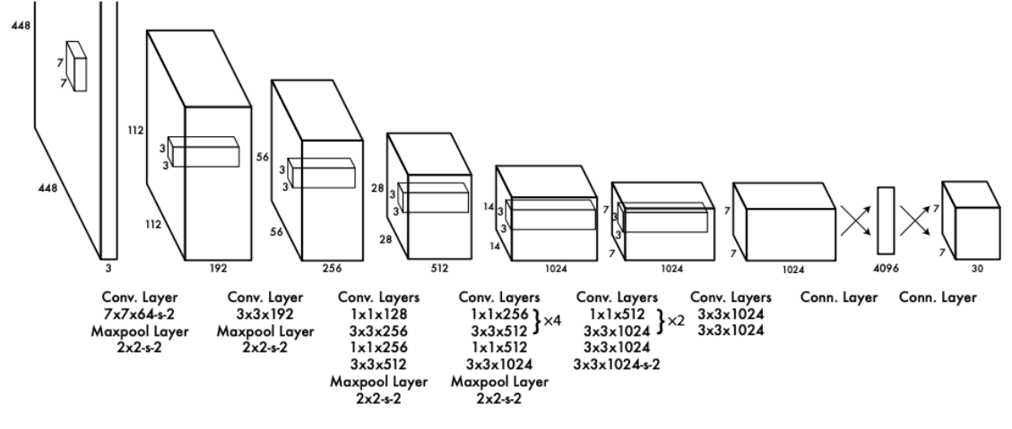
Object Detection Methods: YOLO
The image is converted into 7 × 7 × 1024 feature maps, with S × S (S=7 in the original paper) cells estimating object detection boxes.
Each cell predicts 2 bounding boxes and confidence scores, potentially detecting objects it overlaps with.
During training, only one predictor per object is assigned based on the highest IOU with the ground truth.
There is a series of YOLOv2, v3, v4 ... that further improve both accuracy and efficiency

Slide 27
Hands-On Activity: Object Detection with YOLO
Colab: bit.ly/comviz-c4 bit.ly/comviz-4-colb

Slide 28
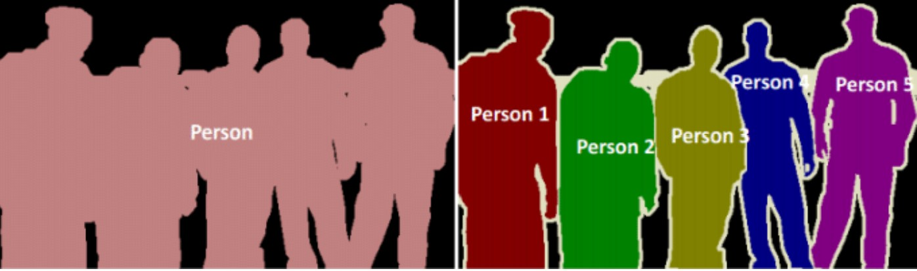
Image Segmentation
Given an input image we wish to obtain:
1. A class label associated to each individual pixel in the image. This is also called pixel-wise localization
2. The probability score associated with each class label
Semantic Segmentation vs Instance Segmentation

Slide 29
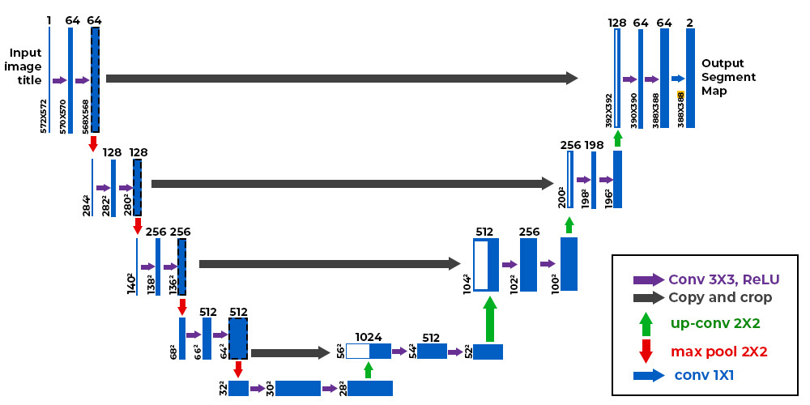
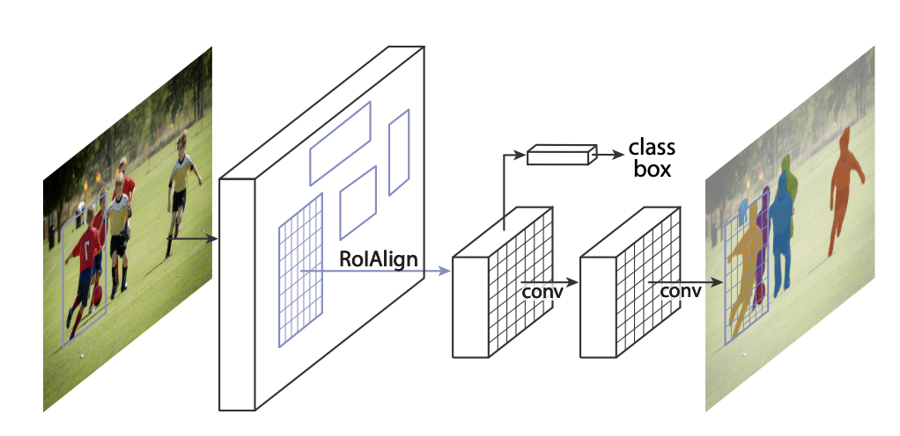
Deep Learning Techniques for Segmentation
U-Net
Mask R-CNN

Slide 30
Hands-On Activity: YOLOv11 for Segmentation
Colab: bit.ly/comviz-c5-1 atau https://bit.ly/comviz-5-colab

Slide 31
Thank you
For other questions,
daniyal.kausar@gmail.com +62 812 2674 9611

